Slide 1
Prognostics-Based Qualification for Product Reliability Demonstration
Abhishek Ram and Dr. Diganta Das (diganta@umd.edu)
Center for Advanced Life Cycle Engineering (CALCE)
University of Maryland, College Park
https://calce.umd.edu/
Presented at
Centre for Advances in Reliability and Safety (CAiRS) May 4, 2022 (Wednesday)

Slide 2

Abhishek Ram
Abhishek Ram is currently pursuing his M.S. in Mechanical Engineering at the University of Maryland (UMD), where he is also the president of the IPC Chapter at UMD. He completed his B.S. in Mechanical Engineering with a minor in Applied Mathematics at the University of Massachusetts, Amherst, in December 2019.
Abhishek is working with Dr. Diganta Das for his Master’s thesis. His research focuses on developing qualification testing and screening procedures for electronic components, including insulated gate bipolar transistors. Abhishek’s research also includes applications of prognostics and diagnostics techniques to supplement existing qualification practices.

Slide 3

Dr. Diganta Das
Dr. Diganta Das (Ph.D., Mechanical Engineering, University of Maryland, College Park, B.Tech (Hons), Manufacturing Science and Engineering, Indian Institute of Technology) is an Associate Research Scientist at the Center for Advanced Life Cycle Engineering. His expertise is in reliability, environmental and operational ratings of electronic parts, uprating, electronic part reprocessing, counterfeit electronics, technology trends in the electronic parts, and parts selection and management methodologies. He performs benchmarking processes and organizations of electronics companies for parts selection and management, and reliability practices.
His current research interests include electronic parts supply chain, counterfeit electronics avoidance and detection, light-emitting diode failure mechanisms, and power electronics reliability. In addition, Dr. Das is involved in prognostics-based risk mitigation of electronics. Dr. Das has published more than 75 articles on these subjects and presented his research at international conferences and workshops.
Dr. Das leads the Educational Outreach of CALCE to develop inter-organizational agreements on joint educational programs, training and internship programs, and professional development. He had been an Associate Editor of the journal Microelectronics Reliability. He is a Six Sigma Black Belt and a member of IEEE, IMAPS, and SMTA.

Slide 4
The information provided in this presentation has been compiled by the
University of Maryland
Replication rights of all information is retained by individual presenters, their respective organizations, and CALCE. Reproduction or distribution of either printed or electronic versions of this material in whole or in part is strictly prohibited, with the sole exception of distribution to registered attendees by the meeting organizers at CAIRS - Centre for Advances in Reliability and Safety .
Copyright CALCE and the University of Maryland. All rights reserved.

Slide 5
Presentation Abstract (1/2)
Qualification is a process that demonstrates whether a product meets or exceeds specified requirements. Testing and data analysis performed within a qualification procedure should verify that products satisfy those requirements, including reliability. Across the aerospace, automotive, and consumer goods industries, products have been found unreliable and unsafe, resulting in recalls even after the qualification process conducted by the supply chain. For example, consider the discontinuation and recall of the Samsung Galaxy Note 7 after flaws in the batteries led to thermal runaway and explosions, costing Samsung billions of dollars.
This presentation introduces the application of prognostics and diagnostics techniques to analyze real-time data trends while conducting qualification tests. We call this method for obtaining and analyzing testing data in real-time is called prognostics-based qualification. Diagnostics techniques identify and predict anomalous behavior exhibited by the product, and prognostics techniques forecast how the product will behave during the remainder of the qualification test and how the product would have behaved if the test continued.

Slide 6
Presentation Abstract (2/2)
Prognostics and diagnostics techniques applied to products in operation have demonstrated success in anomalous behavior detection and product behavior forecasting for improving product sustainment. Using these techniques during qualification can enhance the effectiveness of the qualification procedure. For instance, diagnostics and prognostics techniques can reduce the time required to verify that the product meets or exceeds the qualification requirements. Also, prognostics-based qualification can further improve understanding of product failure and product behavior in various conditions before entering its intended application.
Observations collected from prognostics-based qualification are also applicable throughout the product life cycle, from design to operation. For example, knowledge about product failure and product behavior highlights product vulnerabilities that future product development should eliminate. Another example is that this information can be the basis of a prognostics and health monitoring system in the intended product application, improving product sustainment and contributing to future product development.

Slide 7
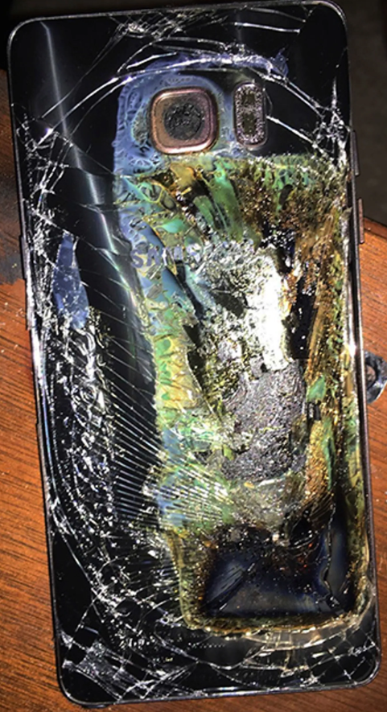
Samsung Galaxy Note 7 Battery Fires and Recall
Samsung had to recall approximately 3 million of its Galaxy Note 7s due to fires triggered by short circuit conditions.
The stress tests performed before large-scale rollout did not cover some of the field use conditions.
As a result, Samsung now includes overcharging, extreme temperature, and nail penetration tests on all its batteries.
D. Christiansen, “Focus on Lithium-Ion Batteries,” IEEE USA Insight, 24 02 2017.
Example of a Samsung Galaxy Note 7 after it caught fire
Phone image from E. P. Ross and A. Silver, “What's Behind Samsung's Phone Fires?” IEEE Spectrum, 14 10 2016.

Slide 8
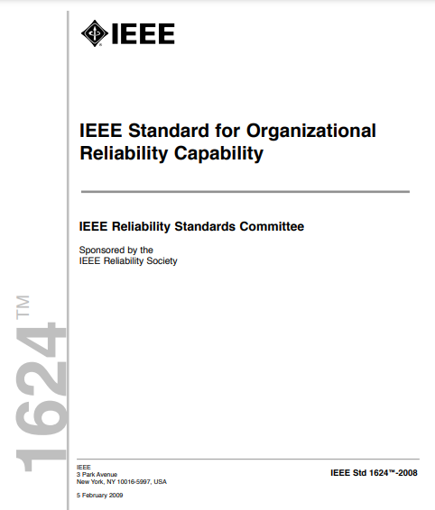
Reliability Program as per IEEE 1624: Standard for Organizational Reliability Capability
IEEE 1624 defines a reliability program as the collection of an organization’s practices to ensure a particular product’s reliability requirements are satisfied.
IEEE 1332 states the minimum reliability requirements a reliability program should include are:
Product functionality
Duration / desired lifetime
Reliability metrics
Life cycle profile
IEEE 1332: Standard Reliability Program for the Development and Production of Electronic Products, New York City, NY: IEEE, 2013.
IEEE 1624: Standard for Organizational Reliability Capability, New York City, New York: IEEE, 2008.

Slide 9
What is Qualification?
Qualification is the process of demonstrating that a product can meet or exceed specified requirements.
The purpose of tests performed within product qualification is to demonstrate that products will satisfy those requirements.
Qualification should be conducted to match the product reliability program requirements.

Slide 10
Product Qualification Methods
Examples of methods for developing and conducting qualification:
Application-agnostic
Physics-of-failure based
Prognostics-based
One can use any of these three methods or combine these methods. The compliance with reliability program requirements will vary depending on the selected method(s).
This presentation provides examples of using these qualification methods together and separately.

Slide 11
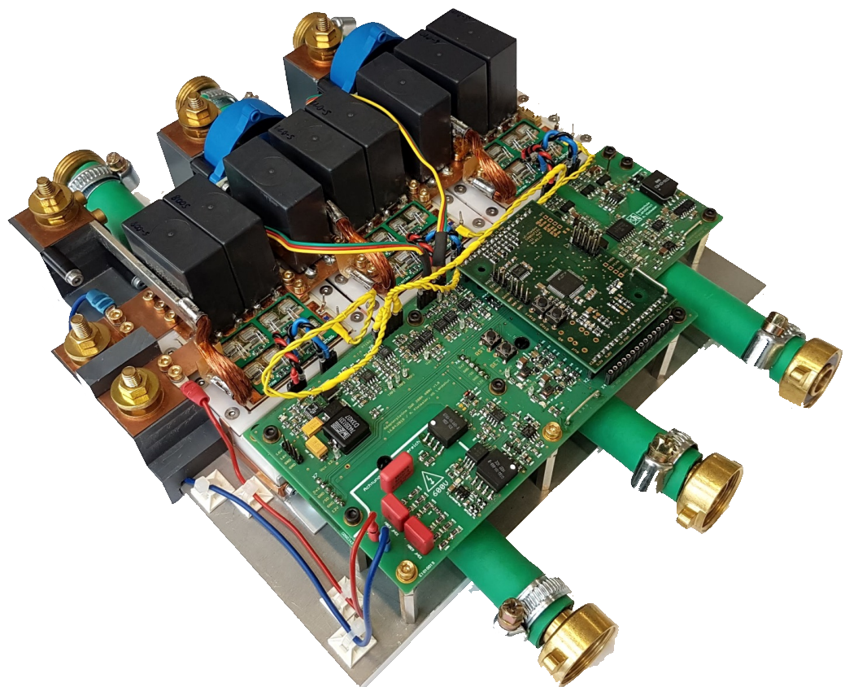
Hybrid Vehicle Traction Inverter
Discrete power electronic components are used in a hybrid vehicle’s traction inverter, which converts energy from the vehicle battery to drive the vehicle’s motors.
The traction inverter application’s qualification requirements should differ from other high power switching applications, such as home appliances or uninterruptible power systems.
Example of a Traction Inverter
Traction Inverter Image from: Huber, T., Kleimaier, A., & Kennel, R. (2019). Centralized Short-Circuit Detection for Multiphase Inverters. International Exhibition and Conference for Power Electronics, Intelligent Motion, Renewable Energy and Energy Management (pp. 362-368). Nuremberg, Germany: Power Conversion and Intelligent Motion - Europe.

Slide 12
Application-Agnostic “Qualification”
Application-agnostic “qualification” is our term for using the procedures from previously reported or recommended practices and not from the intended application.
Examples of application-agnostic “qualification” methods include:
Manufacturer-reported qualification
Qualification standards

Slide 13
Manufacturer-Reported Qualification
Example of an IGBT qualification report found in a process change notification for the original discrete IGBT manufacturer
Manufacturers report this qualification as conducted by them.
These may be stand-alone qualification reports or be included in a process change notification.
Test Conducted | Test Method | Test Conditions | Test Duration | Number of Samples Failed
High Temperature Reverse Bias (HTRB) | JESD22-A108 | Ambient temperature 150°C, 80% of maximum rated voltage | 1008 hr | 0/231
High Temperature Gate Bias (HTGB) | JESD22-A108 | Ambient temperature 150°C, 100% of maximum rated voltage | 1008 hr | 0/231
Temperature Cycling (TC) | JESD22-A104 | -55°C < Temperature < 150°C | 1000 cycles | 0/231

Slide 14
Application-Agnostic “Qualification” for the Discrete IGBT
The application-agnostic approach is common in the industry, but it generally does not consider product reliability requirements.
Therefore, a qualification procedure stemming from manufacturer-reported qualification cannot meet the requirements set by IEEE 1332.
For example, the automotive company knows only that the discrete IGBT is tested to the conditions reported.
Load Experienced
Actual Loading Profile Experienced by Discrete IGBT Mapped to Testing Time
Loading Profile Set by a High Temperature Reverse Bias (HTRB) Test from AEC-Q101 (80% of maximum rated voltage and 150°C)
End of Test
Testing Time

Slide 15
Physics-of-Failure Based Qualification
Physics-of-failure based qualification accounts for:
The intended product application
Product characteristics
Critical failure mechanisms
These factors determine the tests conducted, the testing conditions, and the testing durations.
Development of a physics-of-failure based qualification requires:
Development of a life cycle profile
Prioritization of failure mechanisms

Slide 16
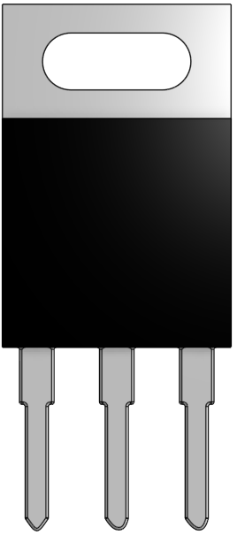





Physics-of-Failure Based Qualification for the Discrete IGBT
In the traction inverter application, three types of loads the discrete IGBT could experience include:
Temperature cycling
Power inputs
Vibration
Vibration
Temperature Cycling
Power Inputs

Slide 17
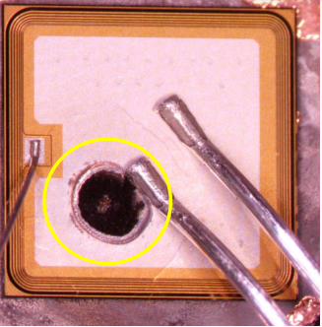
Example of Prioritizing Failure Mechanisms: IGBT Failure
De-encapsulated IGBT
Analyzing a discrete IGBT failure, the IGBT die burned and a crack formed on the die surface near the wirebonds.
It is hypothesized that the effects of temperature cycling and electrical loads contributed to this failure.
Burn
Crack

Slide 18
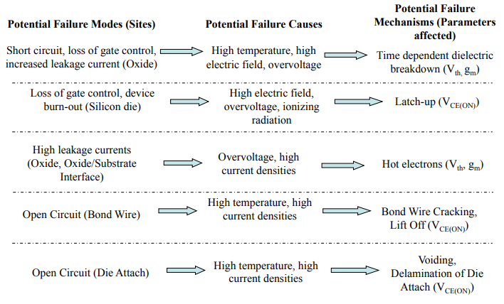
Example of Prioritizing Failure Mechanisms: IGBT Failure
Potential Failure Modes and Failure Sites
Life Cycle Profile Conditions
Potential Failure Mechanisms
Next prioritize the failure mechanisms using the results of failure analysis and the life cycle profile.
In the case of this IGBT failure, the failure mechanisms that contributed to the failure appear to be:
Latch-up
Bond-wire failure mechanisms
N. Valentine, D. Das and M. Pecht, "Failure Mechanisms of Insulated Gate Bipolar Transistors (IGBTs)," in 2015 NREL Photovoltaic Reliability Workshop, 2015.

Slide 19
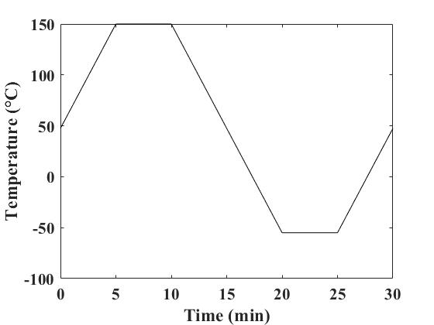
Identifying Qualification Tests to Run – Temperature Cycling Test
Approximation of a Sample Temperature Cycle from JESD22-A104F
Based on the life cycle profile and failure analysis, it is hypothesized that temperature cycling and power inputs contributed to IGBT failure.
Temperature cycling testing evaluates the effect of fluctuating temperatures on the product over its lifetime.
JESD22-A104F: Temperature Cycling, Arlington, VA: Joint Electron Device Engineering Council, 2020.

Slide 20
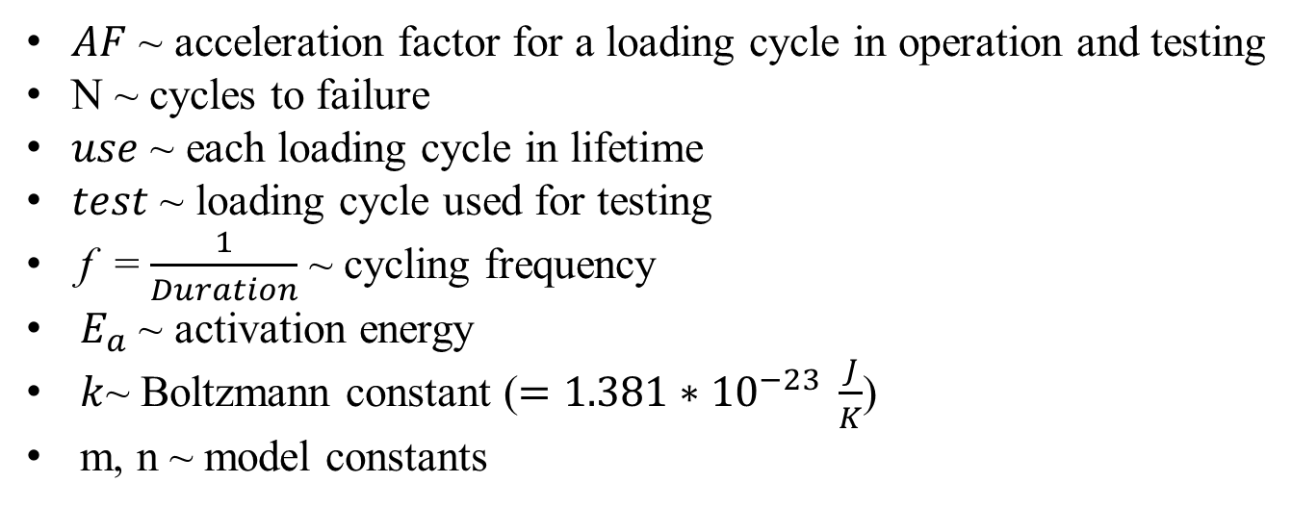
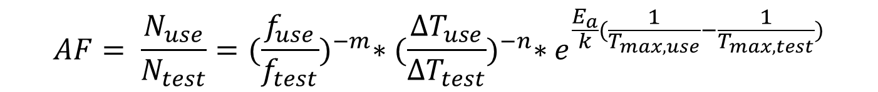
Norris-Landzberg’s Modified Coffin-Manson Model for Temperature Cycling
$$AF= \frac{N_{use}}{N_{test}}={(\frac{f_{use}}{f_{test}})}^{−m}∗{(\frac{∆T_{use}}{∆T_{test}})}^{−n}∗e^{\frac{E_{a}}{k}(\frac{1}{T_{max,use}}−\frac{1}{T_{max,test}})}$$
Norris-Landzberg’s modified Coffin-Manson Model applies for modeling bond-wire fatigue in temperature cycling conditions.
$AF$ ~ acceleration factor for a loading cycle in operation and testing
N ~ cycles to failure
$use$ ~ each loading cycle in lifetime
$test$ ~ loading cycle used for testing
f = $\frac{1}{Duration}$ ~ cycling frequency
$E_{a}$ ~ activation energy
$k$~ Boltzmann constant ($=1.381∗{10}^{−23} \frac{J}{K}$)
m, n ~ model constants
Z. Ni, X. Lyu, O. P. Yadav and D. Cao, “Review of SiC MOSFET Based Three-Phase Inverter Lifetime Prediction,” in IEEE Applied Power Electronics Conference and Exposition (APEC), Tampa, FL, USA, 2017.
F. C. Classe and S. Gaddamraja, “Long Term Isothermal Reliability of Copper Wire Bonded to Thin 6.5 µm Aluminum,” in International Reliability Physics Symposium, Monterey, CA, USA, 2011.

Slide 21
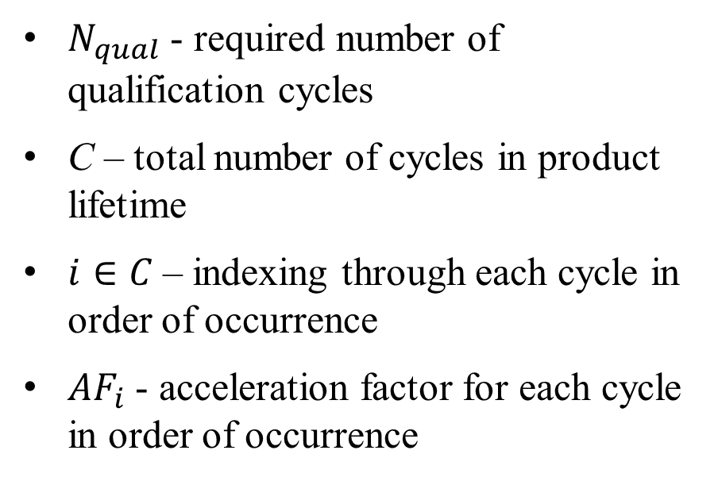

Determining Desired Qualification Conditions
$$N_{qual}= \sum_{i=1}^{C}{\frac{1}{{AF}_{i}}}$$
Identify a desired testing cycle strategy by referencing qualification and test method standards.
Categorize the life cycle loads in order of occurrence in the product lifetime.
For each ordered loading cycle in the life cycle profile, calculate the summation of all loading cycles divided by each acceleration factor.
$N_{qual}$ - required number of qualification cycles
C – total number of cycles in product lifetime
$i∈C$– indexing through each cycle in order of occurrence
${AF}_{i}$ - acceleration factor for each cycle in order of occurrence

Slide 22
Combining Physics-of-Failure Based and Application-Agnostic Qualification
Advantages that Each Qualification Method Provides
Physics-of-Failure based qualification and application-agnostic qualification can complement each other.
However, even this combination of the methods has limitations.
Application-Agnostic Qualification
Physics-of-Failure Based Qualification
Review of qualification tests already conducted on similar component/product
Practices for verifying product performance
…
Product life cycle profile influencing qualification test conditions
Prioritization of failure mechanisms
Product design and operational knowledge
…

Slide 23
Issues with Measuring Product Parameters Before and After Qualification Tests
Some qualification standards only require measuring product parameters before and after the test, and not during the test.
Parameter Value
End of Test
Time 0 & Failure Criteria
Testing Time

Slide 24
Issues with Measuring Product Parameters Before and After Qualification Tests
Some qualification standards only require measuring product parameters before and after the test and not during the test.
However, this means that how product parameters change over the qualification test is unknown.
Parameter Value
?
End of Test
Time 0 & Failure Criteria
Testing Time

Slide 25
Issues with Measuring Product Parameters Before and After Qualification Tests
Unexpected product parameters changes are not observed with measurements only before and after the qualification test.
Parameter Value
Normal Parameter Trend
End of Test
Actual Parameter Trend
Time 0 & Failure Criteria
Testing Time

Slide 26
Issues with Measuring Product Parameters Before and After Qualification Tests
Unexpected product parameters changes are not observed with measurements only before and after the qualification test.
Any anomalous behavior or degradation would not be observed during testing.
Parameter Value
Expected Product Parameter Trend
End of Test
Example of a Product Failure Parameter Trend
Example of Intermittent Failure
Time 0 & Failure Criteria
Testing Time

Slide 27
Real-time Measurement During Qualification Test
Real-time measurement of operating and environmental parameters tracks performance trends during the qualification test.
The parameters to measure and the failure criteria can come from:
Product datasheets
Intended application
Qualification standards
Parameter Value
Normal Parameter Trend
End of Test
Time 0 & Failure Criteria
Testing Time

Slide 28
How Else to Use Measured Parameters?
Parameter Value
With parameter measurements occurring in real-time, can one identify unexpected (anomalous) behavior during the test?
Normal Parameter Trend
Anomalous Behavior
Testing Time
Time 0 & Failure Criteria

Slide 29
How Else to Use Measured Parameters?
Parameter Value
With parameter measurements occurring in real-time, can one identify unexpected (anomalous) behavior during the test?
Likewise, can one predict the future parameter measurements and if or when the product fails?
Normal Parameter Trend
Future Parameter Predictions
Testing Time
Time 0 & Failure Criteria
Remaining Time to Failure

Slide 30
Introduction to Diagnostics and Prognostics Techniques
Data-driven diagnostics techniques identify anomalous product behavior at a given time using the measured parameter values.
Parameter Value
Anomalous Behavior (Diagnostics)
Normal Parameter Trend
Testing Time
Time 0 & Failure Criteria

Slide 31
Introduction to Diagnostics and Prognostics Techniques
Data-driven diagnostics techniques identify anomalous product behavior at a given time using the measured parameter values.
Prognostics techniques predict the future product parameter trend and remaining time to “failure.”
Parameter Value
Normal Parameter Trend
Future Parameter Predictions (Prognostics)
Testing Time
Time 0 & Failure Criteria
Remaining Time to Failure

Slide 32
Prognostics-Based Qualification
Parameter Value
Anomalous Behavior (Diagnostics)
Normal Parameter Trend
The application of diagnostics and prognostics techniques to supplement current qualification practices is called prognostics-based qualification.
Future Parameter Predictions (Prognostics)
Testing Time
Time 0 & Failure Criteria
Remaining Time to Failure

Slide 33
Example of Implementing Prognostics-Based Qualification
Identification of Precursor Parameters
Characterizing Precursor Parameter Data
Repeated during each qualification test
Estimating Future Precursor Parameters Trends and Remaining Time to Failure

Slide 34
Applying Prognostics To Qualification Tests
The qualification test could demonstrate:
Little change between subsequent measurements
Longer duration of testing before anomaly manifests
Trend prediction requires more testing to be accurate
Consequently, prognostics in qualification tests could involve:
Identification of precursor parameters to measure based on prioritized failure mechanisms
Anomaly detection calculation and trend analysis every few measurements instead of every measurement

Slide 35
Precursor Parameters
Examples of IGBT precursor parameters and failure mechanisms associated with them
Precursor Parameter | Associated Failure Mechanism
Collector Voltage in Off-State | Bond-Wire Liftoff
Collector Voltage in On-State | Bond-Wire Fatigue
 | Bond-Wire Liftoff
 | Latch-up
Collector Current in Off-State | Latch-up
Gate Voltage | Bond-Wire Fatigue
Precursor parameters are operational and environmental characteristics to measure that track product behavior.

Slide 36
Identifying Precursor Parameters for Failure Precursor Detection
A failure precursor is an event or series of events indicative of an impending failure.
Failure precursors could include:
Changes in precursor parameter trends
Interactions between precursor parameter trends
Combinations of precursor parameter trends
Parameter Values
The changing shape of the precursor parameter trend is a failure precursor in this example.
Testing Time
Failure Criteria

Slide 37
Characterizing Precursor Parameter Trends
Following identification of precursor parameters, the next objective is to characterize precursor parameter trends and identify failure precursors.
Two approaches for characterizing precursor parameter trends include:
Classifying real-time precursor parameter measurements
Using regression to analyze changes in precursor parameter trends

Slide 38

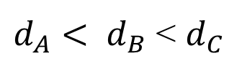


Supervised Anomaly Detection
Supervised anomaly detection uses predefined criteria for identifying healthy behavior and anomalous behavior.
In this example, the K-Means Clustering algorithm uses predefined data clusters to identify healthy (green) and abnormal (blue or pink) behavior.
Anomalous Data Cluster
$d_{A}< d_{B}$ < $d_{C}$
$$d_{C}$$
$$d_{A}$$
$$d_{B}$$
Anomalous Data Cluster
Healthy Data

Slide 39
Unsupervised Anomaly Detection
Hyperplane that Separates Data Clusters
Unsupervised anomaly detection assumes most of the data in an unlabeled dataset is healthy data.
Unsupervised anomaly detection then determines the data points that are anomalous relative to the dataset.
In this example, a support vector machine (SVM) separates two clusters of data based on their distance from each other.
Healthy Data
Anomalous Data
Original, Unlabeled Dataset
Identified Clusters of Data Using SVM

Slide 40
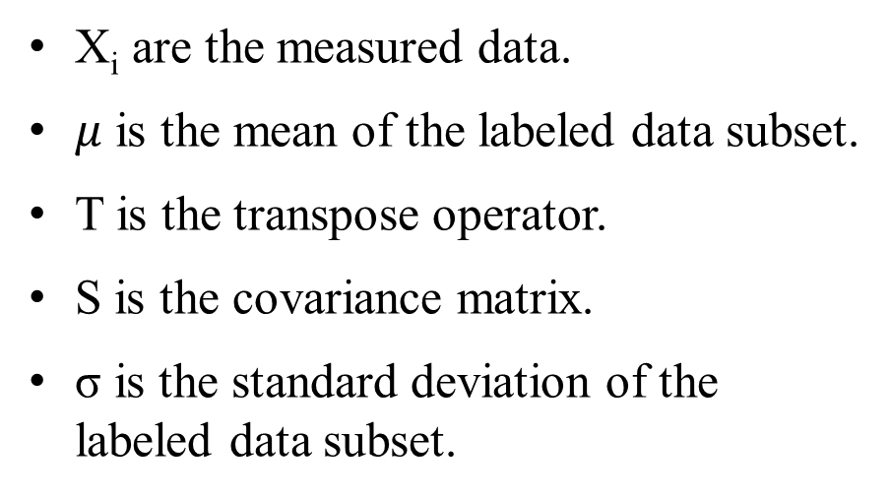
Mahalanobis Distance (MD)
Mahalanobis distance is the distance between a data point and a set of data.
Mahalanobis distance accounts for correlations in the data set to estimate the distance.
Mahalanobis distance is semi-supervised anomaly detection method, where some of the dataset is labeled as healthy data, and the rest begins unlabeled.
$$MD\left(X_{i}\right)= \sqrt{{(X_{i} − μ)}^{T}S^{−1}(X_{i} − μ)}$$
X_{i} are the measured data.
$μ$ is the mean of the labeled data subset.
T is the transpose operator.
S is the covariance matrix.
σ is the standard deviation of the labeled data subset.

Slide 41
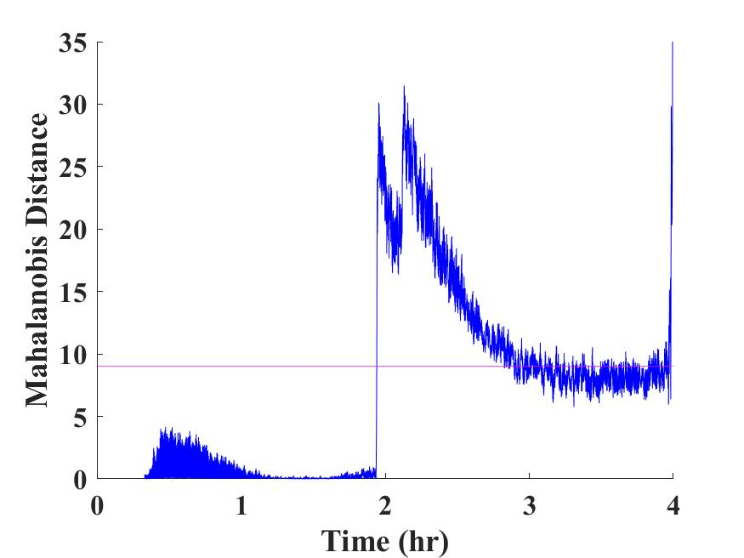
Mahalanobis Distance for Measured Parameters
Analyzing individual parameters allows identification of observed failure mechanisms.
Analyzing multiple parameters together can:
Provide a multivariate estimate of system health
Identify failure mechanisms that are associated with multiple parameters
Example of Mahalanobis Transformation of a Parameter Trend
Anomalous Boundary
Mahalanobis Distance
Time

Slide 42
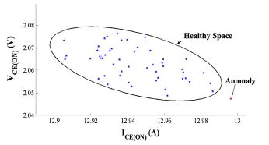
Example of IGBT Prognostics: Anomaly Detection for Insulated Gate Bipolar Transistors
Boundary Between Healthy and Anomalous Behavior (μ+3σ)
Patil et al. used Mahalanobis distance for in-situ IGBT anomaly detection under highly accelerated electrical-thermal stresses.
The authors identified anomalous behavior 57% and 77% of the time before the failure occurred using collector-emitter voltage and collector-current measurements.
Healthy Space
μ – mean of healthy data
σ – standard deviation of healthy data
Anomaly
Example of classified healthy IGBT behavior and anomalous behavior
N. Patil, D. Das and M. Pecht, “Anomaly detection for IGBTs using Mahalanobis distance,” Microelectronics Reliability, vol. 55, pp. 1054-1059, 2015.

Slide 43
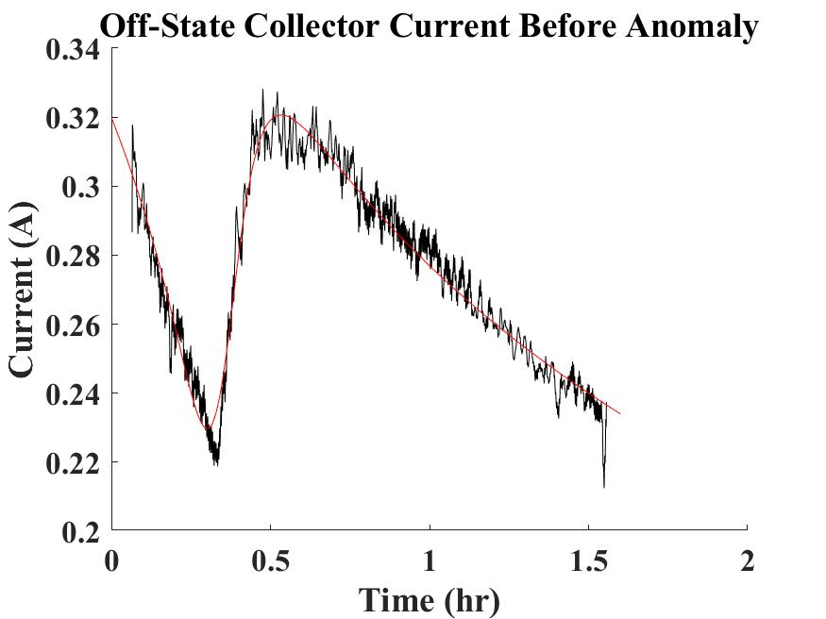
Regression of Product Behavior Using Precursor Parameters
Example of a Precursor Parameter Trend
Regression seeks a direct, data-driven relationship between input and output.
The results from regression could also be used as an input for classification.
Measured Data after Applying Moving Average
Trend Fit Using a Rational Function
Time
Notes:
Regression is the process of relating outputs of a model as a function of the inputs.

Slide 44
Estimating Future Precursor Parameters Trends and Remaining Time to Failure
After failure precursor identification, estimate the remaining time to failure by predicting the future precursor parameter trend.
In this example, a particle filter predicts mean time-to-failure by identifying possible paths the precursor parameter trends could follow.
Parameter Values
Normal Product Behavior
Estimation of Possible Future Paths the Trend Can Follow
Anomalous Behavior
Mean Estimated Parameter Trend Path
Probability Distribution of Time to Failure
Testing Time
Failure Criteria
Remaining Time-to-Failure Estimation

Slide 45
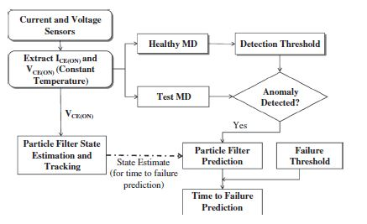
Example of IGBT Prognostics: Time to Failure Prediction Using Particle Filters
Patil et al. used a particle filter for estimating the future collector-emitter voltage trend.
The particle filter predicted the remaining useful life with an approximate underestimation error of 20% by the time the anomaly was detected.
Anomaly Detection and Particle Filter Prognostics Algorithm Proposed by Patil et al.
N. Patil, D. Das and M. Pecht, “A prognostic approach for non-punch through and field stop IGBTs,” Microelectronics Reliability, vol. 52, pp. 482-488, 2011.

Slide 46
Reduction in Time to Complete Qualification
Parameter Value
Anomalous Behavior (Diagnostics)
Normal Parameter Trend
One might not need to run the qualification test to the end to determine if the product will pass the test.
Future Parameter Predictions (Prognostics)
End of Test
Time 0 & Failure Criteria
Testing Time
Remaining Time to Failure

Slide 47
Reprioritizing Failure Mechanisms Based on Observed Parameter Trends
Parameter Value
Expected Parameter Trend During Failure
Analysis of parameter trends could reveal the need for reprioritizing failure mechanisms.
Actual Parameter Trend During Failure
Time 0 & Failure Criteria
Testing Time

Slide 48
Use Qualification Test Measurements for Future Product Development
Parameter Value
Information about product behavior gathered during qualification can be used to inform future product development.
In this example, the observed intermittent anomalous behavior can be eliminated in future versions of the product.
Intermittent Anomalous Behavior
Normal Parameter Trend
End of Test
Time 0 & Failure Criteria
Testing Time

Slide 49
Ability to Supplement Prognostics and Health Management (PHM) Systems
Methods for identifying anomalous behaviors corresponding to different failure mechanisms can be found during qualification.
That information can be used in a PHM system to potentially reduce the number of no-fault-found failures.
Anomalous Behaviors From Qualification Tests
Normal Parameter Trend
Parameter Value
Anomalous Behavior Found in Operation
Time 0 & Failure Criteria
Operating Time

Slide 50
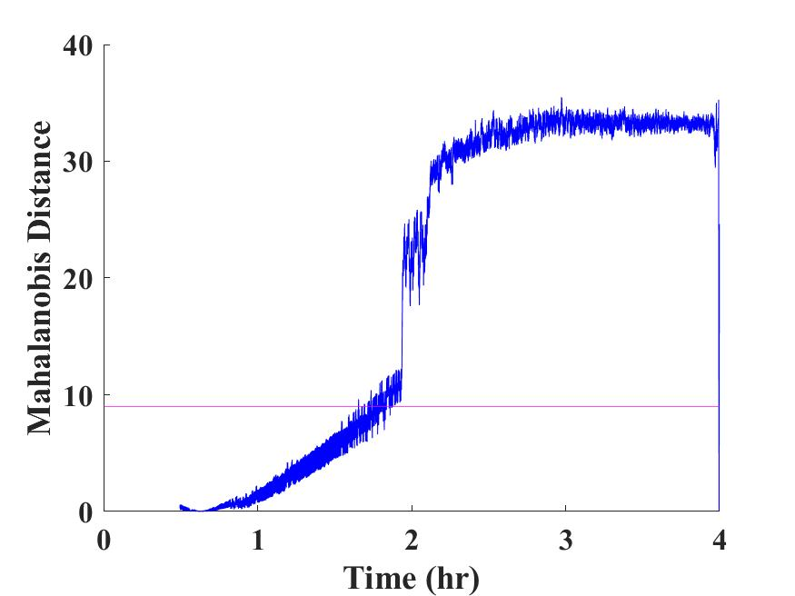
Example of Observing Multiple Failure Mechanisms
Off-State Collector Current
Mahalanobis Distance
Off-State Collector Voltage
Mahalanobis Distance
Transformed Anomalous Boundary
Transformed Anomalous Boundary
Mahalanobis Distance
Mahalanobis Distance
Precursor Parameter for Latch-Up
Precursor Parameter for Bond-Wire Liftoff

Slide 51
Ability to Supplement Prognostics and Health Management (PHM) Systems
Parameter Value
Anomalous Behavior (Diagnostics)
Normal Parameter Trend
The methods for detecting anomalous behavior and calculating remaining time to failure in qualification tests can be applied to a PHM system in operation.
Future Parameter Predictions (Prognostics)
Testing Time
Time 0 & Failure Criteria
Remaining Time to Failure
Operating Time
Remaining Useful Life

Slide 52
Ability to Supplement or Fill in for Prognostics and Health Management (PHM) Systems
Normal Parameter Trend
Anomalous Behavior (Diagnostics)
An initial predictive maintenance and spare delivery schedule can be developed during product qualification.
This reduces the potential for unexpected failures and system downtime.
Parameter Value
Future Parameter Predictions (Prognostics)
Testing Time
Time 0 & Failure Criteria
Maintenance Action / Spare Requested
Remaining Time to Failure
Operating Time
Remaining Useful Life

Slide 53
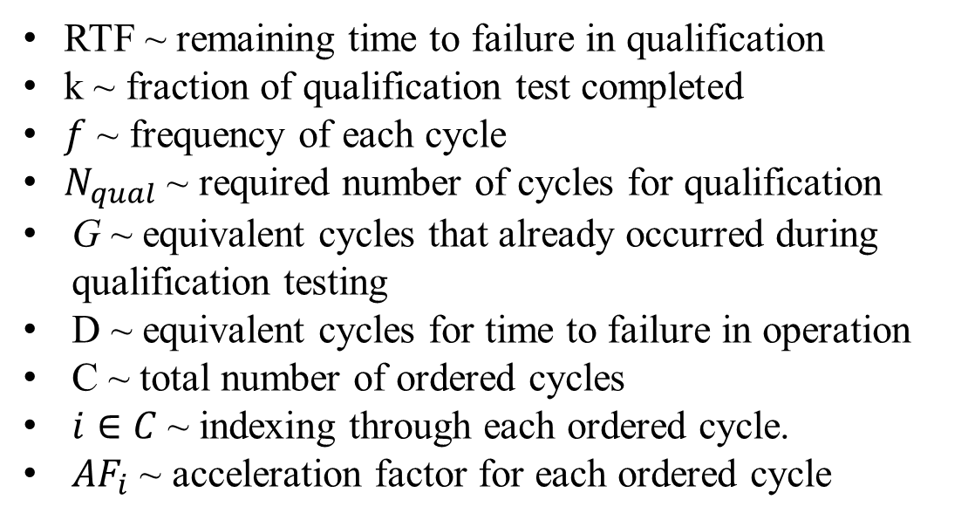


Identifying Remaining Time to Failure Using Acceleration Factor
$${k∗N}_{qual}= \sum_{i=1}^{G}{\frac{1}{{AF}_{i}}}$$
Determine the fraction of the test completed by the time of product failure (k).
Use the time-categorized life cycle profile to estimate when this failure would have occurred in the product lifetime.
Sum the durations of remaining loading cycles to estimate the remaining useful life.
$$RTF ≅ \sum_{i=G}^{D}{\frac{1}{{{AF}_{i}∗f}_{i}}}$$
RTF ~ remaining time to failure in qualification
k ~ fraction of qualification test completed
$f$ ~ frequency of each cycle
$N_{qual}$ ~ required number of cycles for qualification
G ~ equivalent cycles that already occurred during qualification testing
D ~ equivalent cycles for time to failure in operation
C ~ total number of ordered cycles
$i∈C$~ indexing through each ordered cycle.
${AF}_{i}$ ~ acceleration factor for each ordered cycle

Slide 54
Closing Observations
Prognostics-based qualification improves current qualification practices by analyzing product behavior during testing.
Prognostics-based qualification applies specifically to product application by:
Reducing the time required for product qualification
Reprioritizing failure mechanisms to improve the qualification procedure
Beyond qualification, prognostics-based qualification can potentially:
Inform future product development
Supplement a prognostics and health management system
Improve product sustainment

